Slide 1
GROCERY SHOPPing APP
Amber Tepshi
Armena Ballo
Emla Kurti
Eria Dhespollari
“ONE CKLICK” TEAM

Slide 2
TABLE OF CONTENTS
INTRODUCTION
INTENDED AUDIENCE
SOFTWARE PROCESS MODEL
CUSTOMER & ADMIN APPLICATIONS
FUNCTIONAL AND NON_FUNCTIONAL REQUIRNMENTS

Slide 3
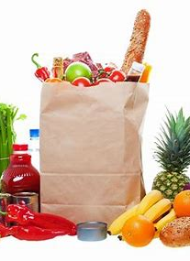
Introduction
The pace of life nowadays is quite intense, and often people don't have enough time to fulfill all their needs or tasks. Many people, due to their commitments during the day, often find it impossible to make various purchases by going to stores in person. We have heard a lot about online shopping and deliveries from clothing stores, restaurants, fast food, perfumery, etc. But what is missing, or more precisely is in a fairly limited number, enough to be counted on the fingers of one's hand, are the applications for the purchase and distribution of groceries.
In addition to good time management, another good thing that comes from creating this application is eating healthily. As mentioned above, people, due to the momentum of everyday life, order through online applications to eat during meals mainly foods harmful to health, or as they are otherwise called "junky foods". Therefore, one of the main goals of creating this application is to give people the opportunity to improve their diet and have a healthier physique. Moreover, this application provides convenience and comfort for people with or without a busy life.

Slide 4
Intended audience
Individuals: Nowadays, people are constantly balancing busy schedules. A grocery shopping application is perfect for those who struggle to find the time. They can browse and order items from the comfort of their homes, and have them delivered to their doorstep.
Families: Families nowadays can take advantage of the technology that provides a grocery shopping app, which represents a practical solution because it allows them to manage their purchases more simply and with ease. Through using this application, families get the benefit of creating shopping lists, tracking their orders and reordering items.
Seniors: Seniors who, due to their age, cannot go out and do shopping while carrying heavy weights can choose to use this application in order to get their grocery shopping done. Without having to leave their homes, they can order groceries and have them delivered.
Businesses: In the food service industry, restaurants, cafes and other businesses can optimize their efficiency by making use of modern technology. Specifically, they can turn to grocery shopping apps to order crucial items for their operations with ease and have these items delivered directly to them.

Slide 5
Software process Model
Software Process Model: We intend on using the waterfall model to
develop this application. This is a plan-driven model that includes these phases:
Requirements analysis and definition
System and software design
Implementation and unit testing
Integration and system testing
Operation and maintenance
Despite choosing this model we decided to incorporate elements from
other software process models as well to ensure the best quality product.

Slide 6
Customer and Admin App Functions

Slide 7
Customer App Functions
Profile Creation
Store & Product Selection
Shopping cart Management
Users should be able to create their profile to place and keep track of their orders.
The user will be able to input the necessary information into the app when registering.
Customers should be able to select stores and products they want to purchase and add them to their shopping cart.
They should have the ability to view product details, including descriptions, prices, images, and customer reviews.
Customers should have the ability to manage their shopping cart, including adding or removing items, adjusting quantities, and updating product options.

Slide 8
Customer App Features
Ordering and Checkout
Order Tracking
Customers should be able to place orders for the selected products and proceed to the checkout process.
Customers should be able to track the status and progress of their orders, from confirmation to delivery.
They can view real-time updates about the order status.

Slide 9
Admin App Functions
Dashboard
User Management
Store & Product Management
Order Management
Dashboard is like the homepage of admin’s site.
Since they are responsible for the management of many information the dashboards consist of stores, items, users and orders.
Admins should be able to manage user accounts, including creating new accounts, removing accounts, modifying user information, and handling account-related issues.
Admins should have the ability to add, edit, and delete products and stores.
They can update product details, such as name, description, price, and images.
Admins should have access to view and manage customer orders.
They can process orders, update order status and handle order cancellations.

Slide 10
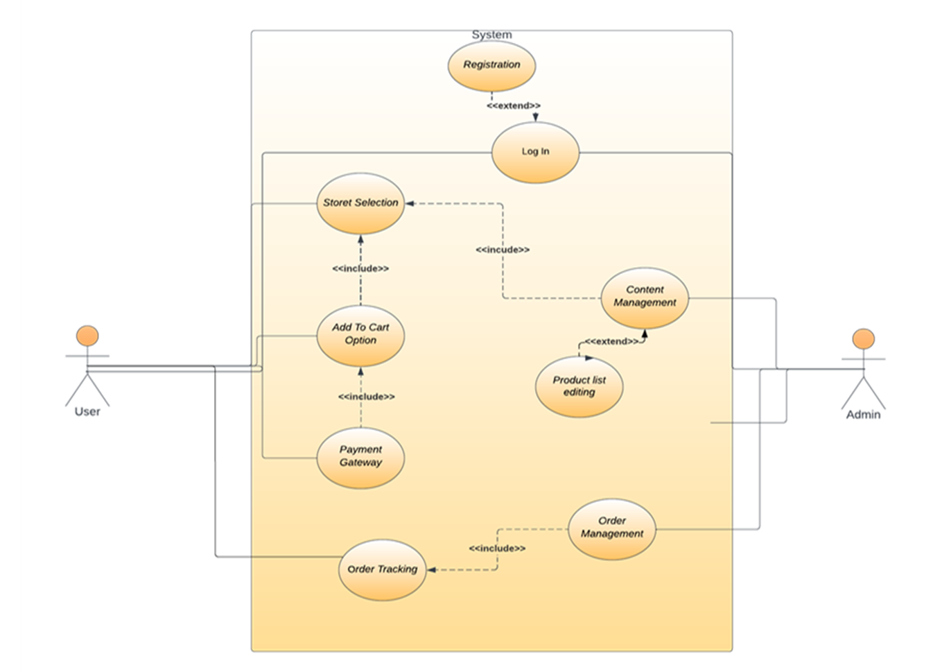
Functional and non-functional requirenment

Slide 11
Customer Functional Requirements
The app should provide an intuitive and user-friendly interface for easy navigation and product discovery.
The app should support smooth and secure processing.
The shopping cart should maintain accurate product quantities and update prices.
The app should provide real-time order tracking to keep customers informed about their orders.
The app should ensure data privacy and security, protecting customers' personal information.
The customer support feature should be easily accessible, allowing customers to seek assistance or resolve any issues promptly.

Slide 12
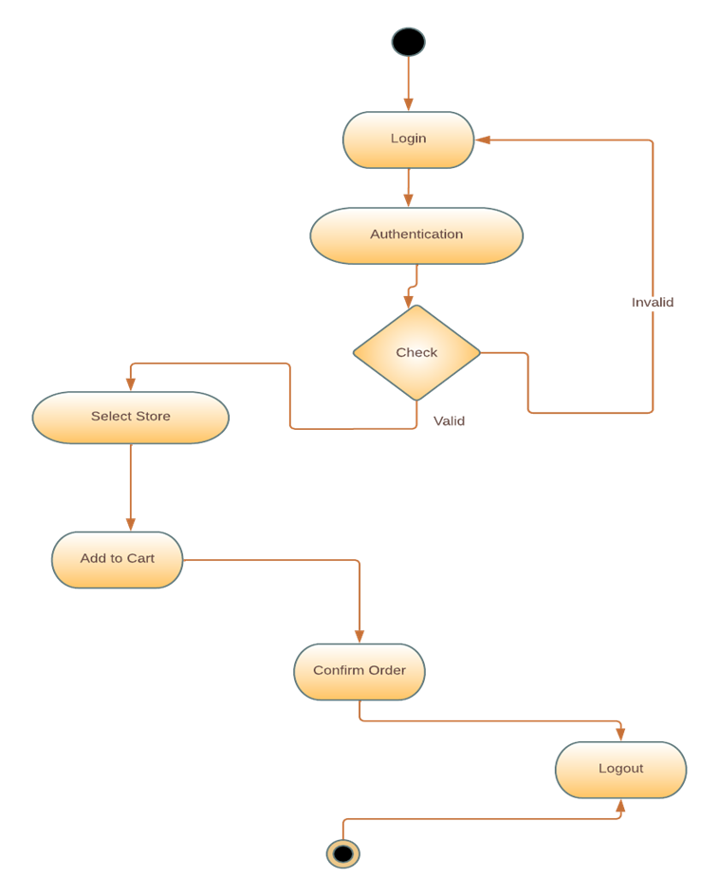
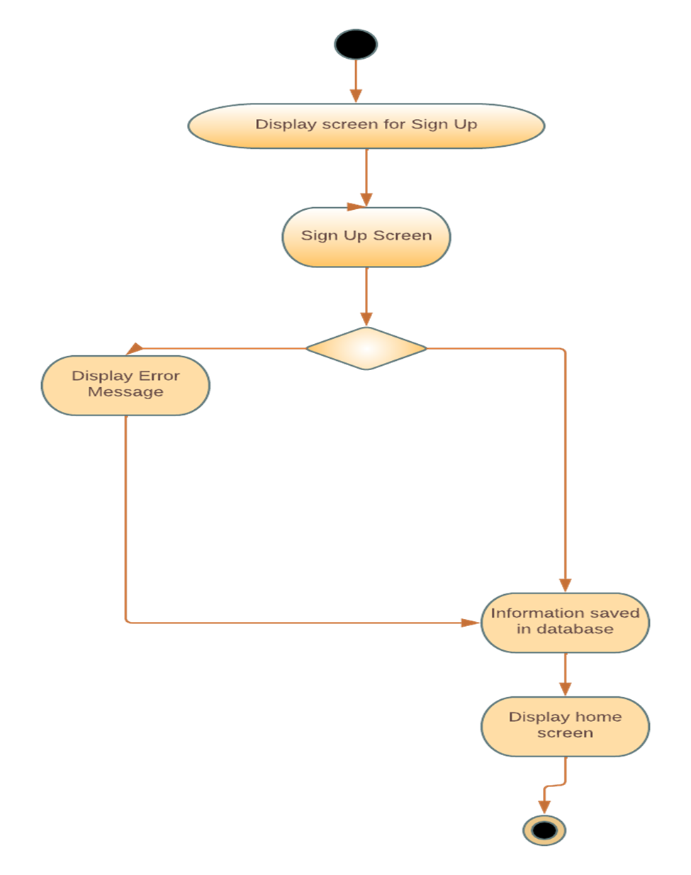

Slide 13
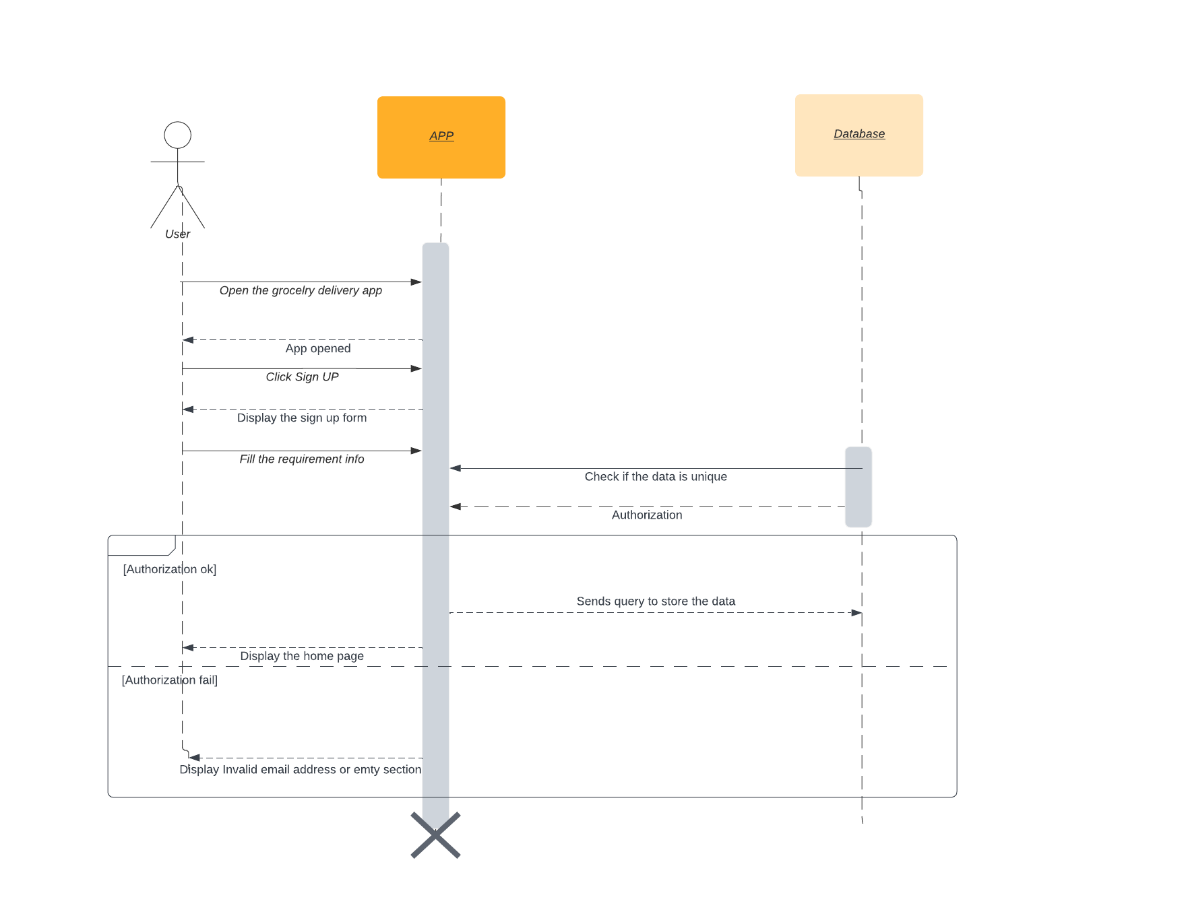

Slide 14
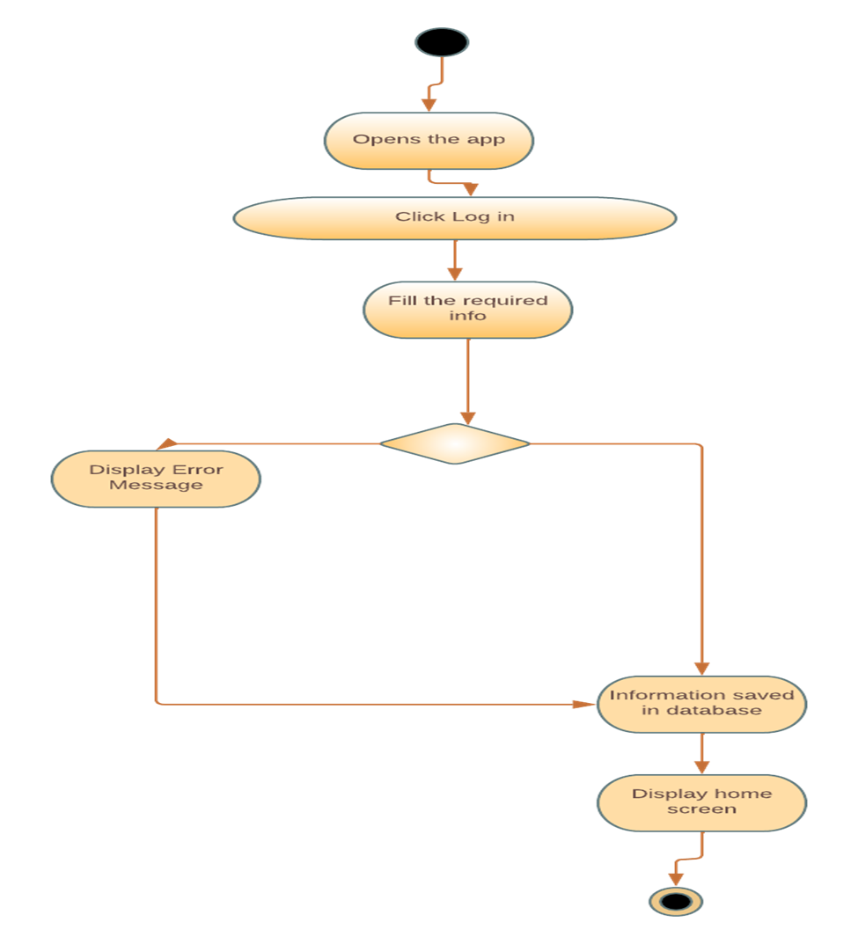
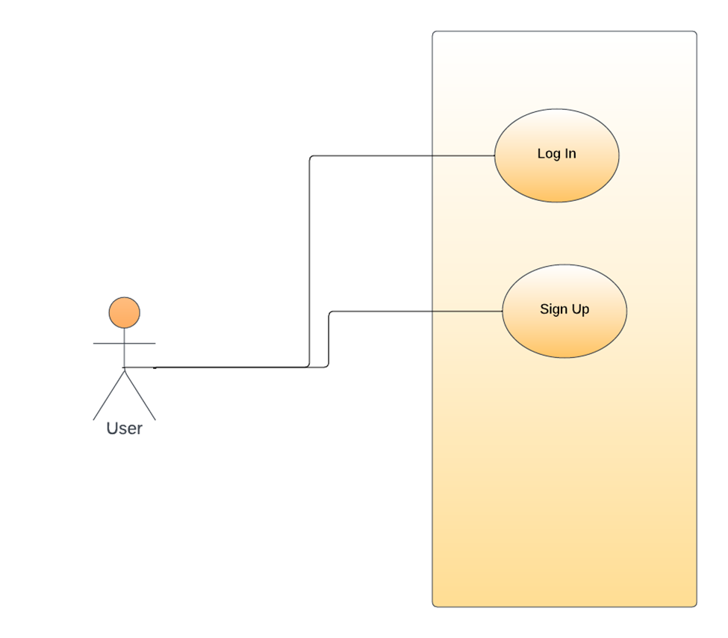

Slide 15
Admin Functional Requirements
The admin interface should provide secure access through authentication and authorization mechanisms.
The app should offer an intuitive and user-friendly admin dashboard for easy management of users, products, and orders.
Admins should have the capability to perform bulk actions, such as bulk product uploads, inventory updates, or order processing.
The admin interface should have robust data management capabilities, ensuring data integrity and accuracy.

Slide 16
Application non - Functional Requirements
Performance
Scalability
Reliability
Security
Usability
Compatibility
Accessibility
Compliance

Slide 17
Design and Implementation Constraints
Regulatory compliance
Hardware limitations
Interfaces to other applications
Security considerations
Design conventions and programming standards
Budget constraints

Slide 18
User Interfaces
Customer Interface:
The buyer interface will have a graphical user interface (GUI) that is both user-friendly and aesthetically pleasing.
A home page with featured goods and stores, a shopping cart screen, and an order tracking screen.
Consistency in design components including fonts, colors, icons, and layout will be maintained by adhering to GUI standards and product family style guides.
The screen layout will be created with the most important information prioritized, making it simple for customers to browse and choose products.
On the relevant screens, common buttons and options like "Home," "Your orders," "Shop," and "Sign in/ Log out" will be present.
In order to give consumers clear information in the event of any problems or input errors, error messages will adhere to a uniform format.

Slide 19
Admin Interface:
A grocery shopping app's admin interface gives administrators or support staff the tools and functions they need to administer and keep an eye on the application's general operation. The admin interface has the following significant features:
User Management: Using the admin interface, administrators can create new user accounts, update user information, and address any account-related concerns. Features like user registration, authentication, and password management may be present.
Store Management: Administrators have control over the shops and merchants listed on the app. They can manage any store-related settings or setups, evaluate and approve vendor registrations, and confirm vendor information.
Product Management: The admin interface has tools for managing the platform's available products. Administrators have the ability to add new items, edit existing product information and control pricing.
Order Management: Admins can view and follow orders placed by customers thanks to order management functionalities that are accessible to them. They can handle cancellations, oversee order fulfillment, keep track of order statuses, and engage with vendors and customers about problems or questions relating to orders.

Slide 20
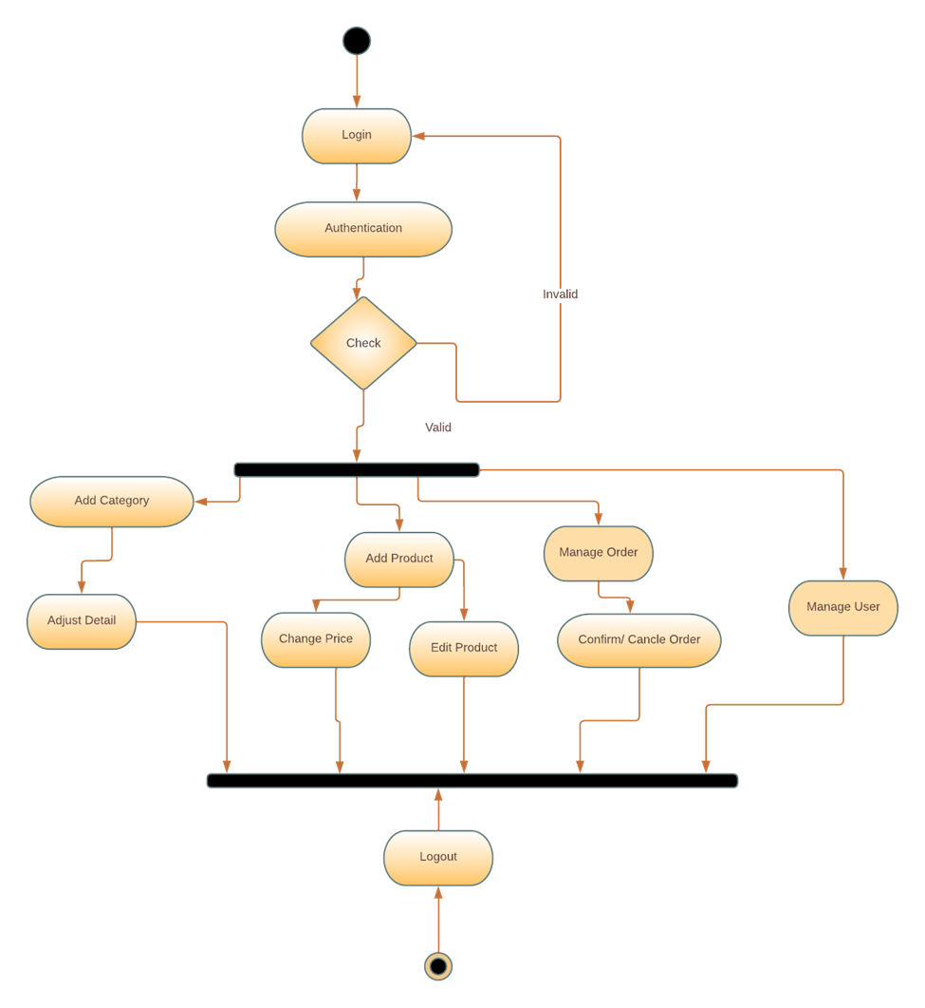

Slide 21
Software Interfaces
Databases: The grocery shopping app is connected to a database management system (DBMS) to store and retrieve data. This DBMS is PHPMYADMIN.
Operating System: The grocery shopping app may be developed to run on specific operating systems such as Windows. The specific version would depend on the target platforms and the app's development requirements.
Tools and Libraries: The app utilizes various development tools and libraries for building specific features. For example, it use programming languages like JavaScript for its interaction, CSS for its styling. HTML for its structure and PHP for its connection and other features. Additionally, frameworks have been employed. There have been many fonts included.

Slide 22
Thank you

